Slide 1
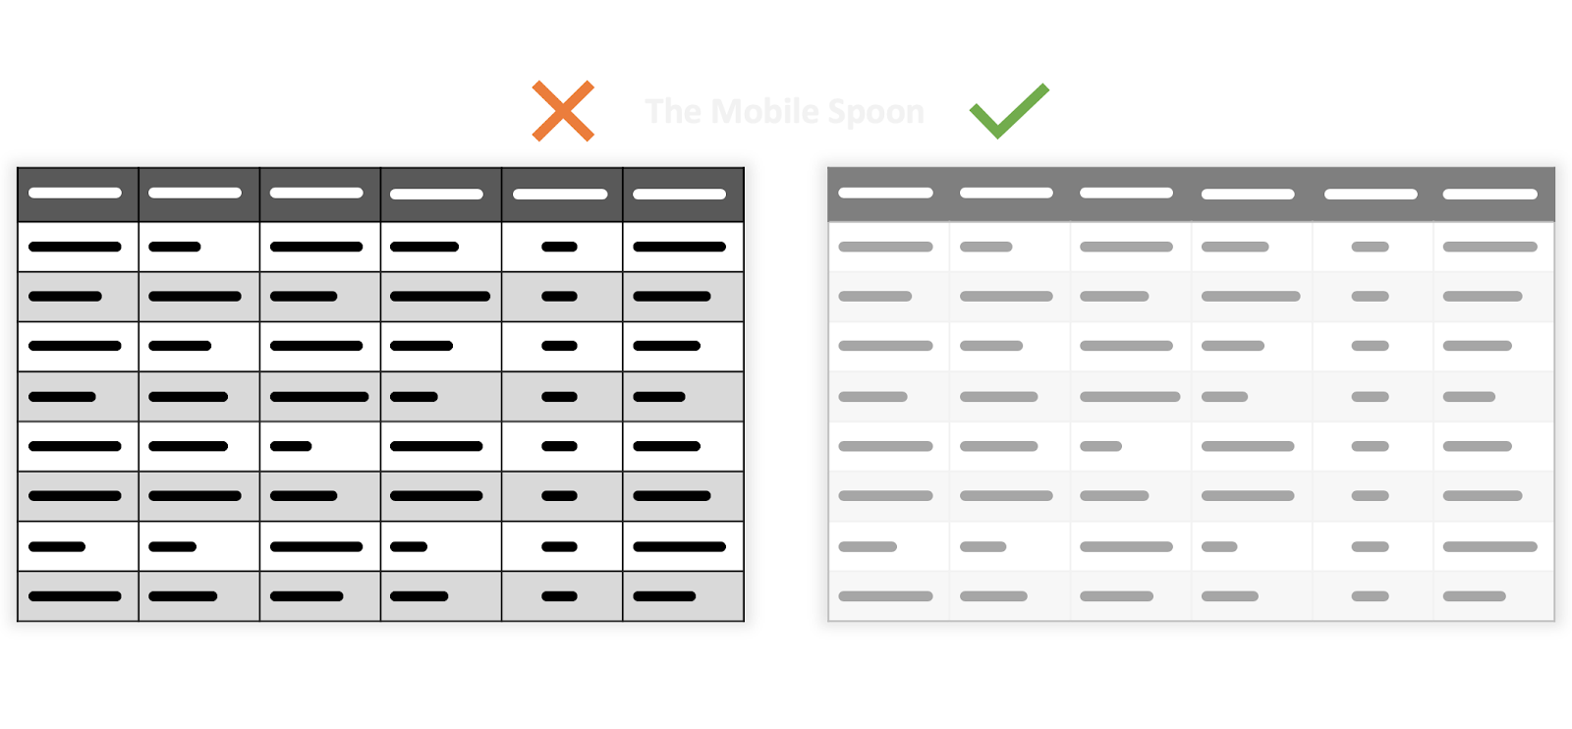



CIS 598 Project Scheduler –
Django Website Application
CIS Final Project by Jason Byrne
Where: https://ksu.zoom.us/j/95728774842
When: 5/13/21 at 12:30 PM
https://www.mobilespoon.net/2019/11/design-ui-tables-20-rules-guide.html
Some Features:
CSV File Support for Importing Data
Only Authorized Users can Alter Information
Colored Text to Easily Distinguish Completed/Incomplete Presentations
https://www.python.org/
https://www.djangoproject.com/
https://www.zdnet.com/article/has-the-time-finally-come-for-postgresql/

